Slide 1
EE 596 – IMAGE AND VIDEO CODING MINI PROJECT
MATARAARACHCHI M.A.R.P.
E/15/224

Slide 2
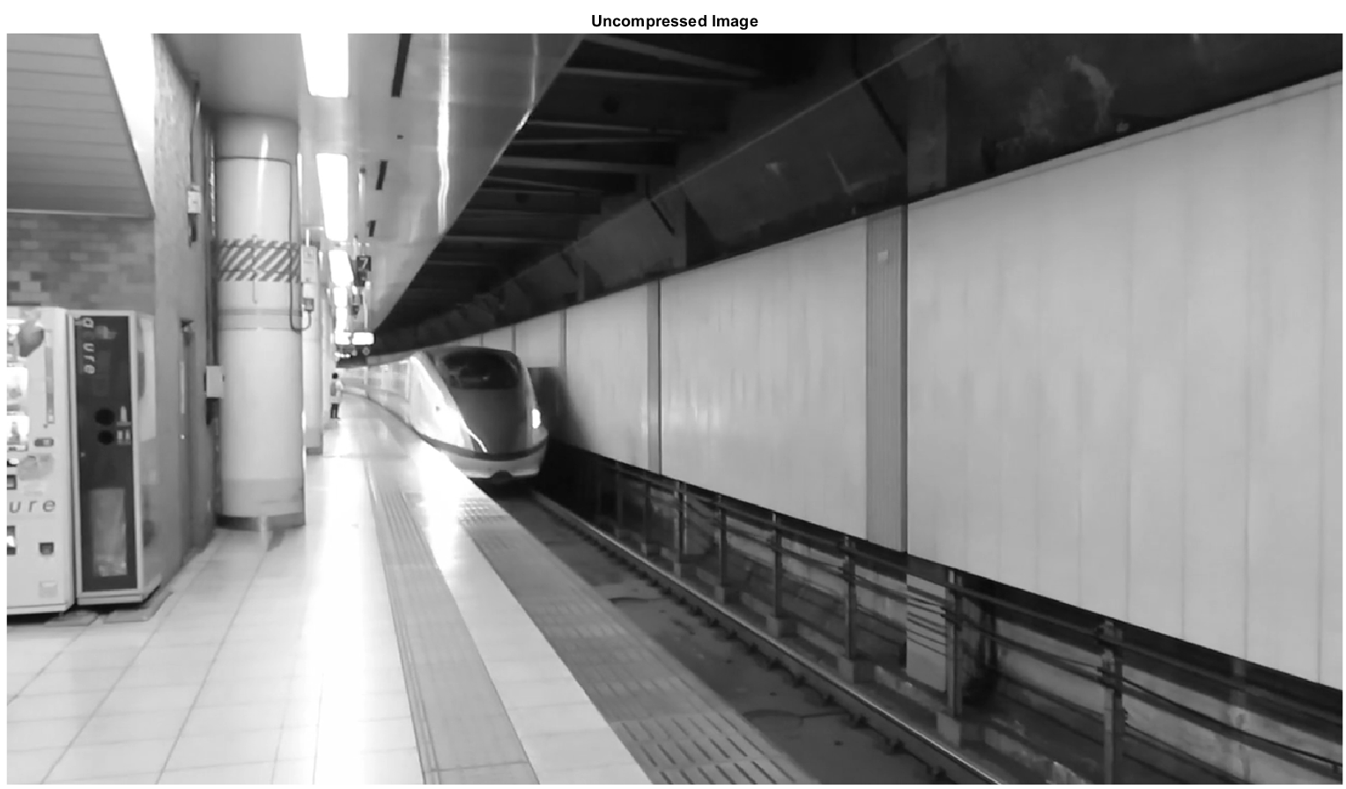
Stage 1: Basic Implementation: Image Compression
Import the image into Matlab
Resolution: 1280x720 pixels (HD)
Gray scale
Uncompressed Image Size: 7.37 Mega Bits = (1280x720x8)/1,000,000)

Slide 3
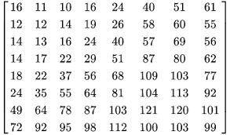
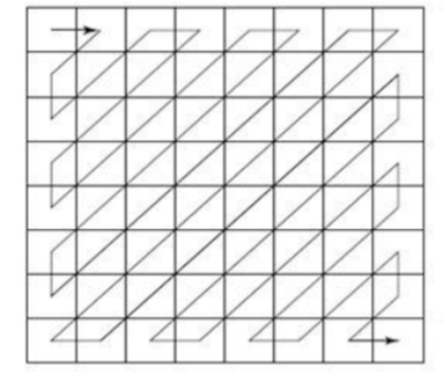
Divide the Image into 8x8 blocks and store in a cell array.
Subtract 128 from all the pixels (Decreases the DC coefficient by 1024).
Transform into frequency domain through Discrete Cosine Transform.
Remove high frequency components by quantizing. Multiply the quantization table by Quantization level.
Round off to the nearest integer.
Zigzag transform the Marco block
Encode AC values by Run Length encoding process.
Finally encode everything by Huffman encoder.
Store bit sequence

Slide 4
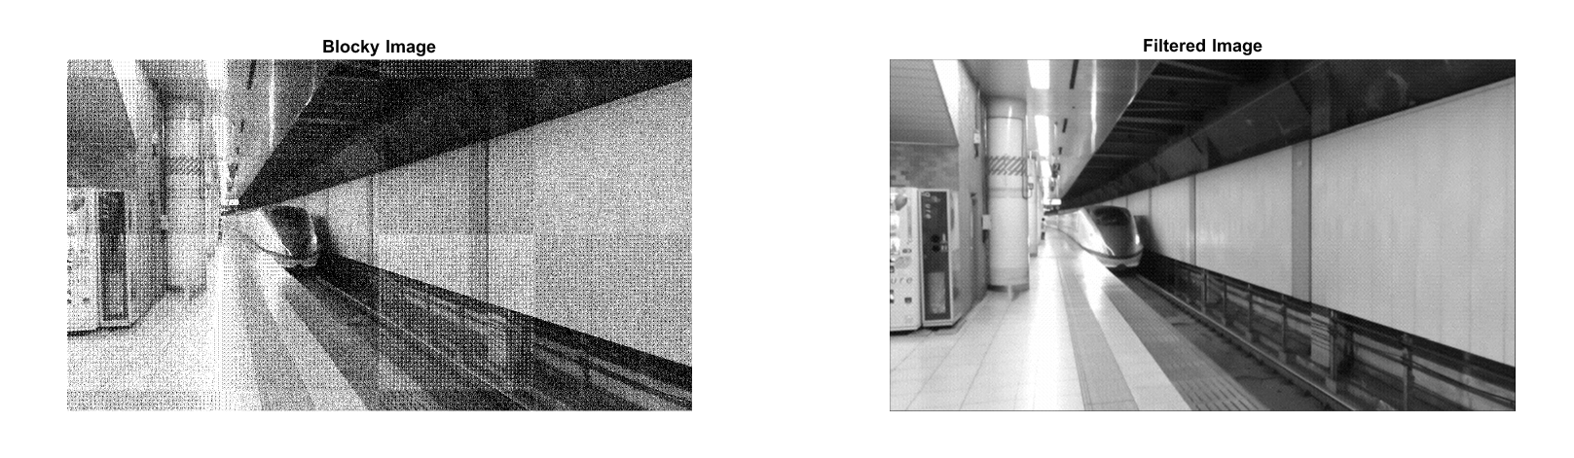
Decoding – Reverse all the above steps
Apply filter to remove blocky-ness (Pixel averaging filter)

Slide 5
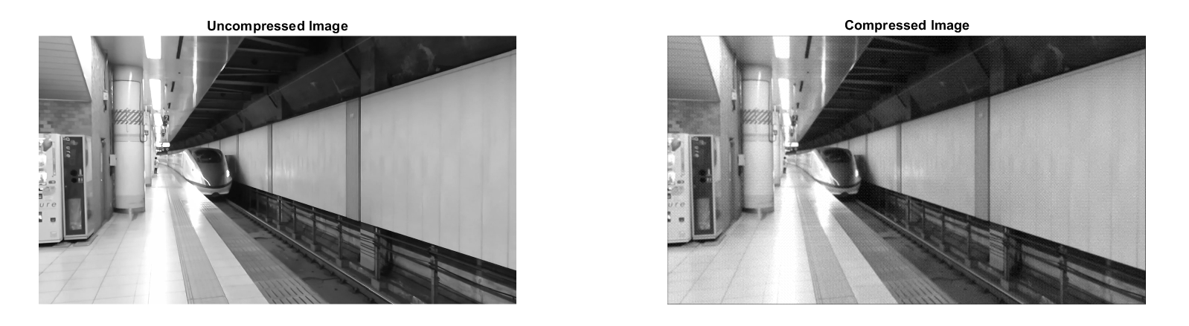
Image before and after compression
Results at quantization level 1:
Bits before compression: 7.3728 Mbtis
Bits after compression: 2.2043 Mbits
Compression Ratio: 3.3448

Slide 6
Stage 2: Basic Implementation 2: Video Compression
Import Video
Specs: Resolution: 1280x720 pixels (HD)
Gray scale
Frame Rate: 30fps
Length: 1s
Uncompressed bitrate: 221.184Mbps =(1280x720x8x30)/1,000,000
Separate the frames into Groups of Pictures (GOP)
GOP format used: IPPPP IPPPP IPPPP …

Slide 7

Remove Temporal Redundancies in each GOP
Done by Motion Estimation
Marco block size: 8x8 pixels
Search Area: 24x24 pixels
Predicted using SAD (Sum of Absolute Difference)
Search method: Sequential Search

Slide 8
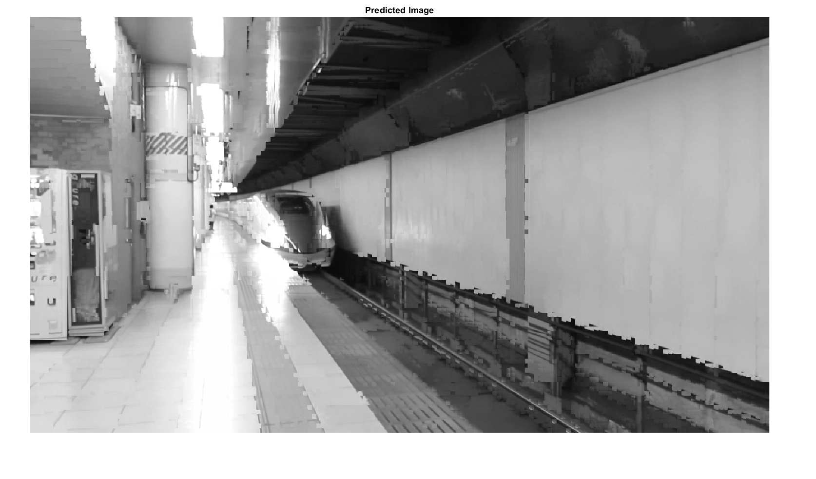
Image Predicted by Motion Vectors

Slide 9
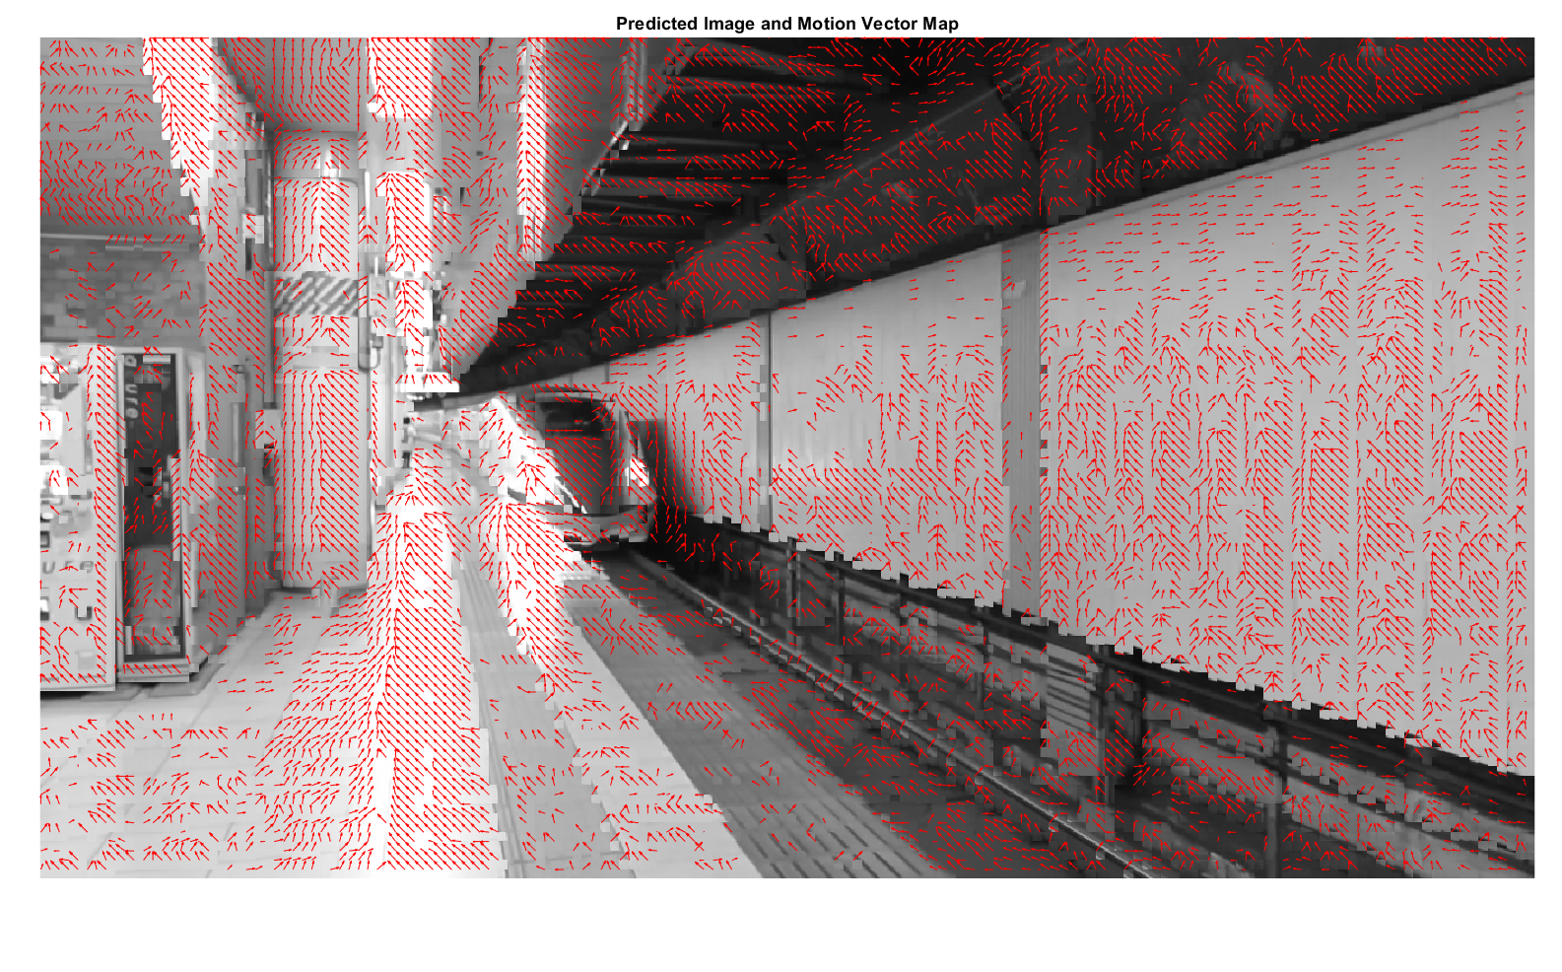
Motion vector map

Slide 10
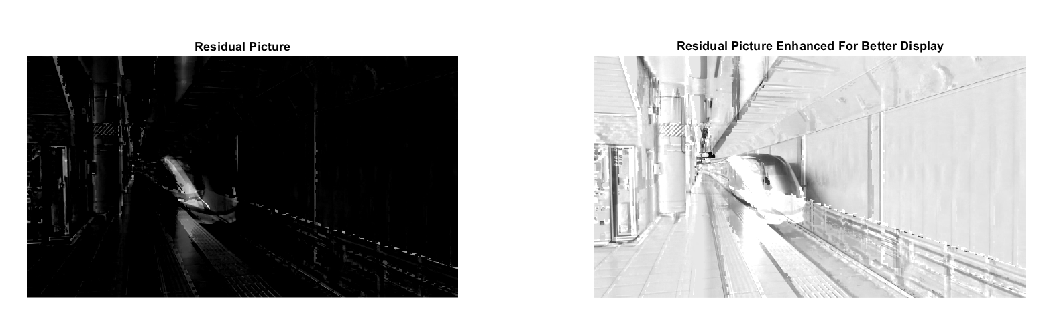
Take the residual by subtracting the predicted frame by the target frame
Send the residuals through the previous Image coding process.
Encode the motion vectors by lossless compression (Only Huffman)
Store bit sequences

Slide 11
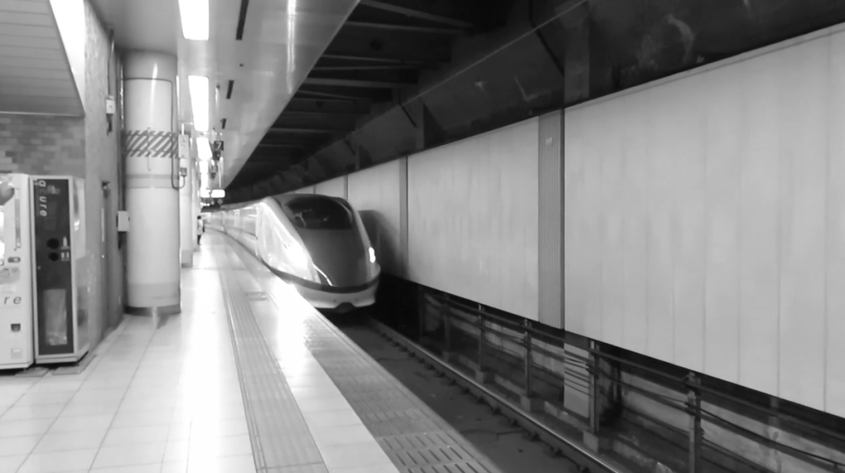

Same frame before and after compression
Before Compression
After Compression
Bitrate of uncompressed video: 221.184 Mbps
Bitrate of compressed video: 16.855 Mbps
Compression factor: 13.122

Slide 12
Stage 3: Improved Hybrid Video Codec
Import video
Specs: Resolution: 640x360 pixels (SD)
Gray scale
Frame rate: 10fps
Length: 1s
GOP: IPPPP IPPPP
Uncompressed bitrate: (640x360x8x10x1) / 1,000,000 = 18.432 Mbps
Bitrate calculation in compressed video: All the bits that should be transmitted in 1 second – Huffman coded residuals, motion vectors, etc.

Slide 13
Optimizing the Quantization level when the bitrate is constant.
We want to calculate the Quantization level at the given bitrate
Write a function to output the bitrate for a given quantization level
Write a search algorithm to find the quantization level which matches best with the given bitrate
Algorithm used: Binary search with decreasing step size.
Optimization process terminates when the algorithms passes a given number
of iterations (10) or when the error is less than a given tolerance value
(0.01Mbps).

Slide 14
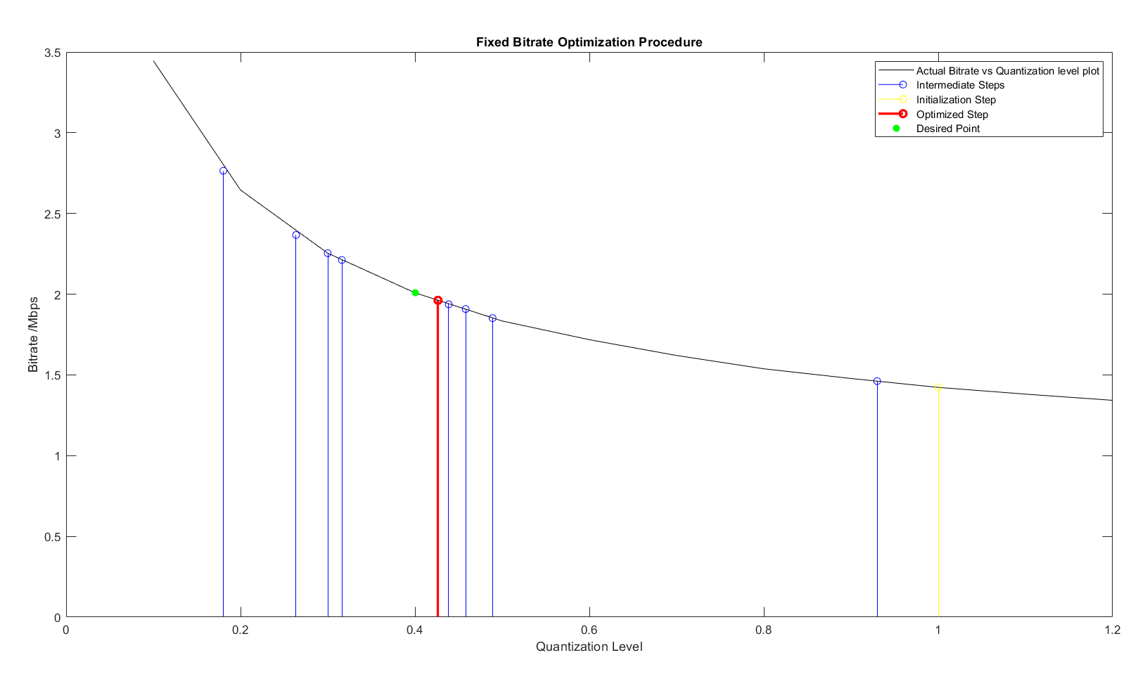
Fixed Bitrate: 2 Mbps
Number of iterative steps until convergence: 10
Optimized Quantization Level: 0.42643
Bitrate at the optimum quantization level: 1.962 Mbps (Error: -0.038Mbps)

Slide 15
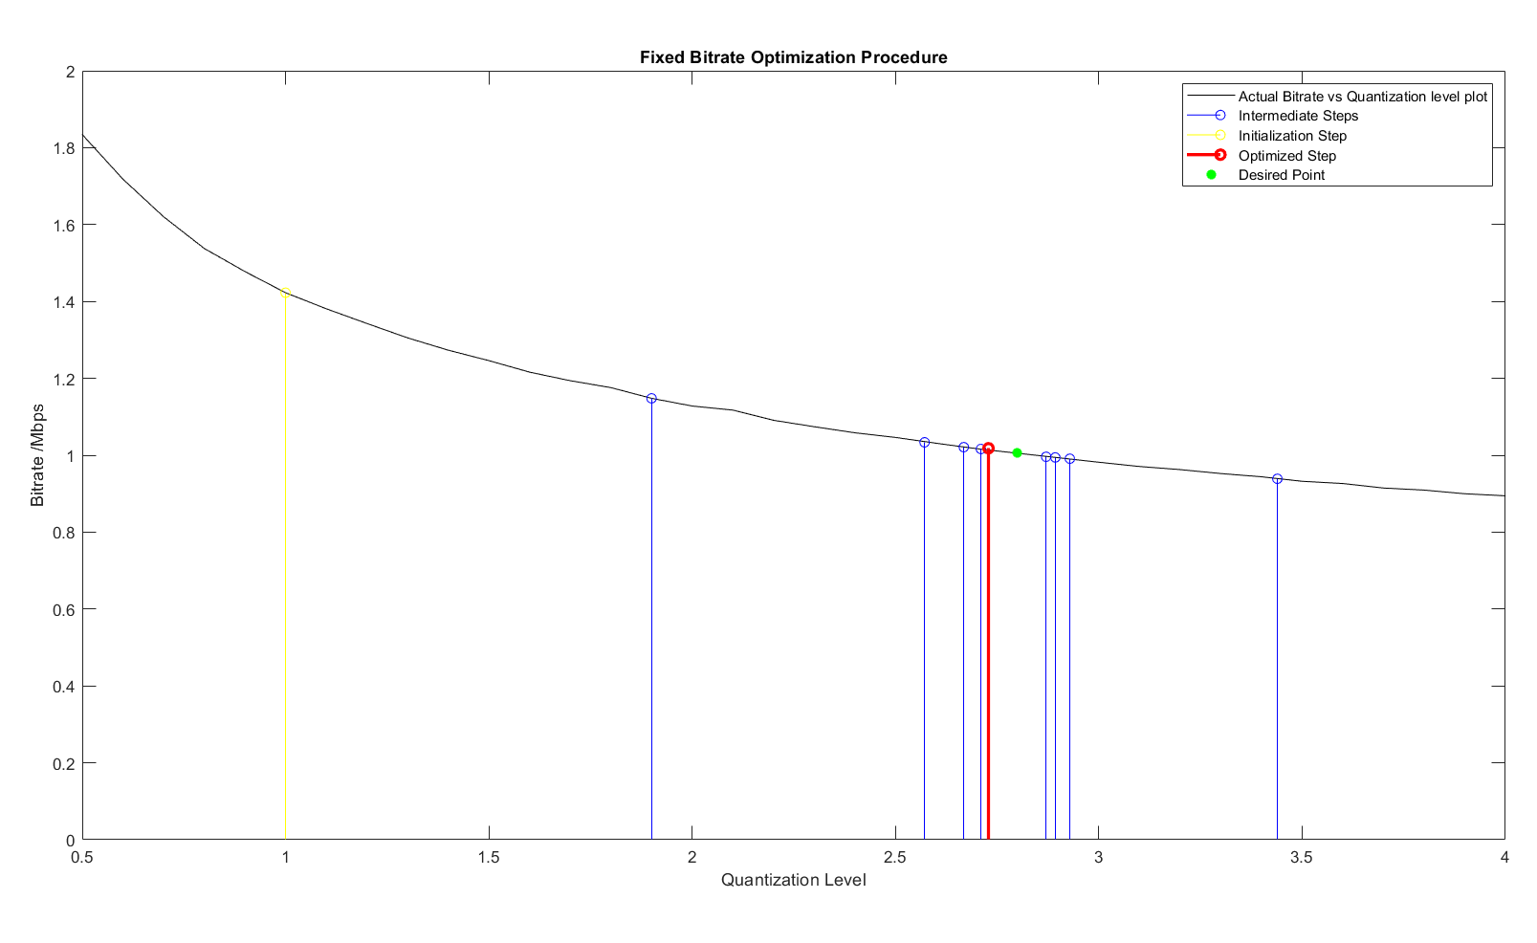
Fixed Bitrate: 1 Mbps
Number of iterative steps until convergence: 10
Optimized Quantization Level: 2.72870
Bitrate at the optimum quantization level: 1.018 Mbps (Error = +0.018Mbps)

Slide 16

Optimizing the Bitrate for a given quality level.
Quality should be measured.
Use VQM – Visual Quality Metric (It is a measure of distortion)
$VQM= \frac{1}{1+e^{0.17×PSNR−25.66}} ;10≤PSNR≤55.$
VQM and quality are related by,
$Quality=\left(100−100×VQM\right)\%$.
Write a function to output the bitrate and the average VQM of all the frames. Decode the video inside the function to get the VQM (feedback loop).
Write a search algorithm as in the previous step to find the bitrate which matches best with the given quality level.

Slide 17
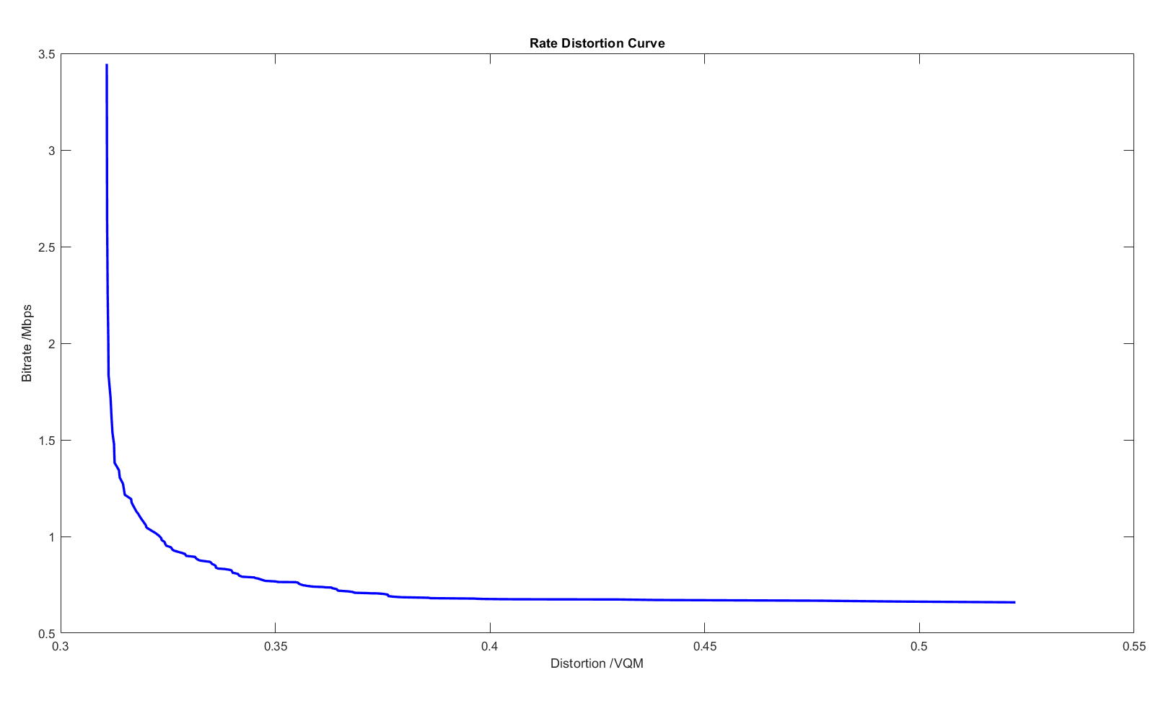
Approximated Rate Distortion Curve

Slide 18
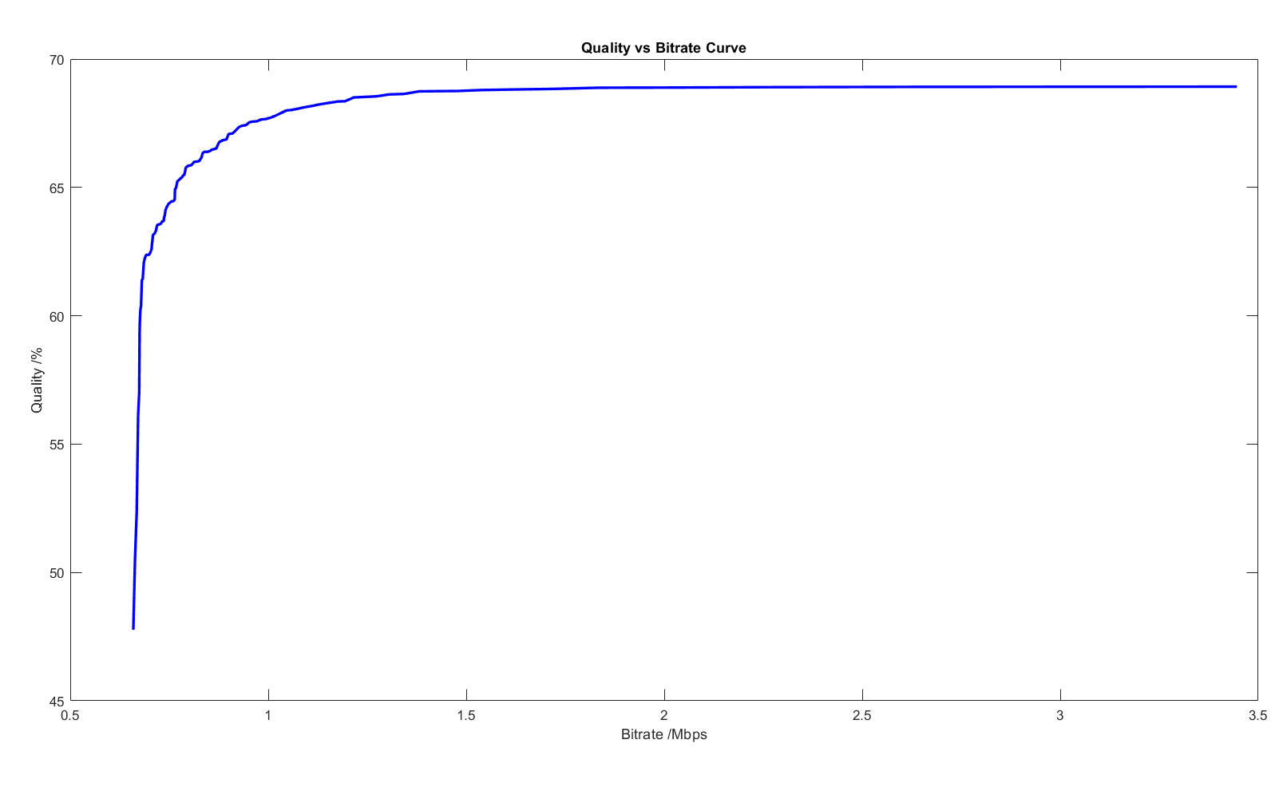
Approximated Quality vs Bitrate Curve

Slide 19
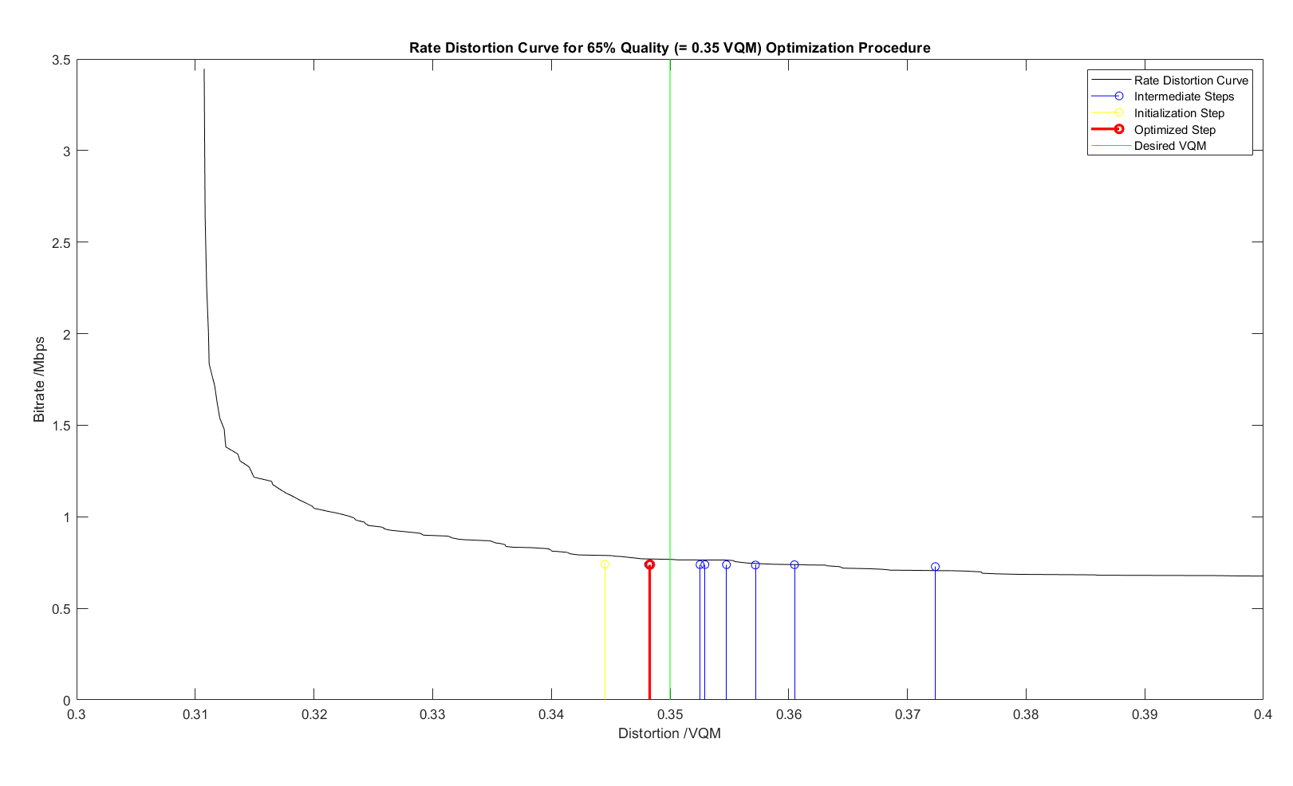
Desired Quality level: 65% (= 0.35 VQM)
Number of iterative steps until convergence: 10
Optimized bitrate: 0.739 Mbps
Quality at optimized level: 65.170% (Error: +0.17%)
Quantization level: 7.06836

Slide 20
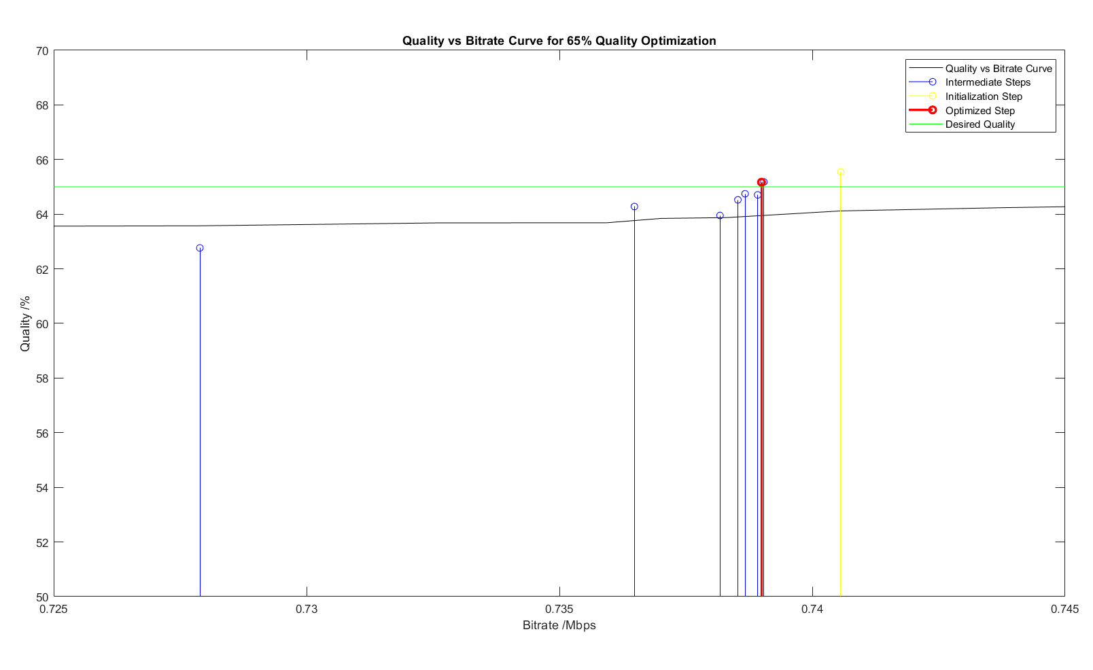

Slide 21
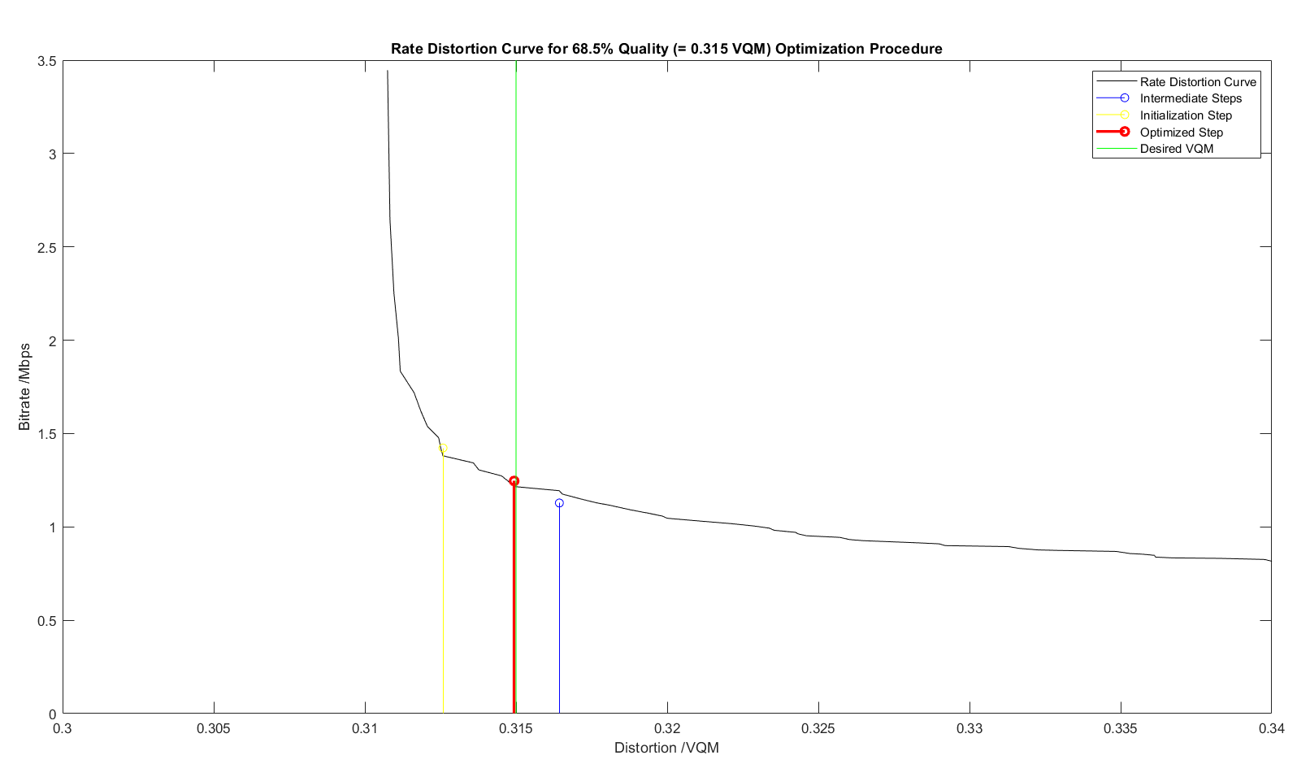
Desired Quality level: 68.5% (= 0.315 VQM)
Number of iterative steps until convergence: 3
Optimized bitrate: 1.246 Mbps
Quality at optimized level: 68.506% (Error = +0.006%)
Quantization level: 1.5

Slide 22
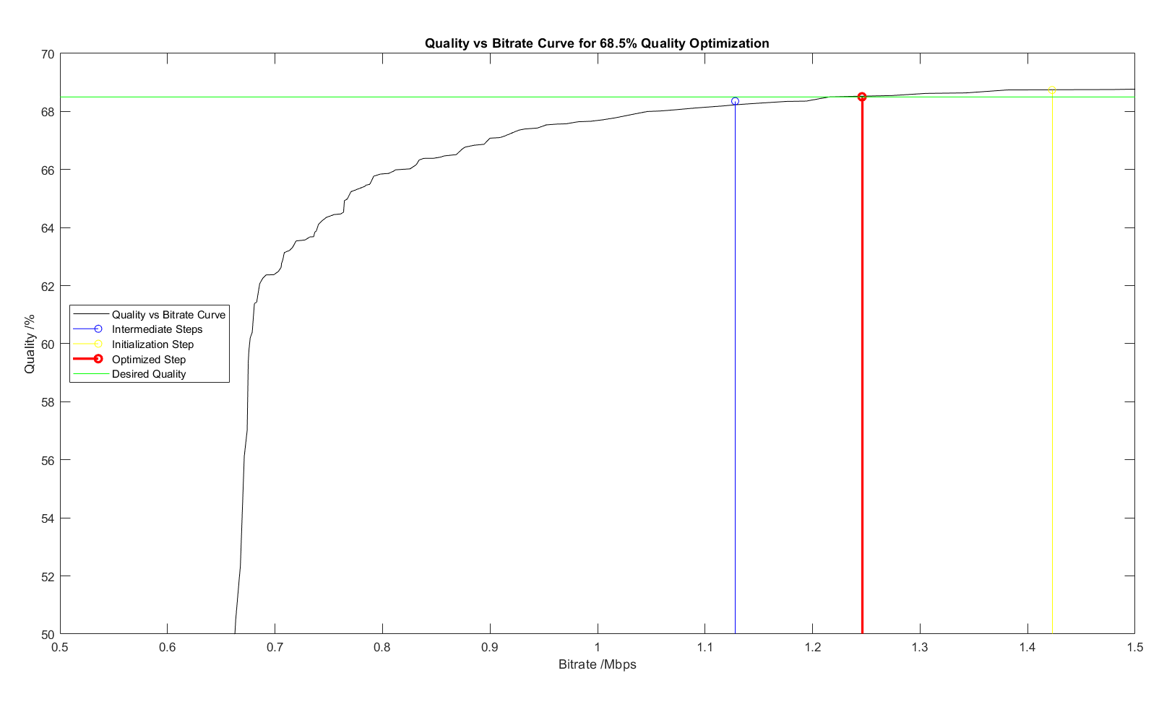

Slide 23
THANK YOU!

